Slide 1
Computer Sharing Centre First Instructor Training Presentation

Slide 2
Introduction
Three main training sessions – then what?
Week one type first week’s date here 1-3pm:
1 - What to expect, the Guides site, useful vocabulary with 12 A3 Poster Guides given out, Google search tips (A4 guide) – to aid learning, Keyboard Navigation (arrange to observe lessons from 11.20 to 12.30)
Week two type second week’s date here 1-3pm:
2 - Managing removable storage (digital camera memory cards and memory sticks), organising folders and files – with guide, revision of week one
Week three type third week’s date here 1-3pm:
Take a 30 minute test to be marked immediately.
If successful: Receive membership Induction including a tour of the Centre
3 – Lesson Processes. Receive an overview of the processes involved in the term of lessons (with two Instructor Guides) – ready to start immediately - with supervision!
Book dates for Monthly Review meetings and Presentations –
Monthly Review meetings
Receive a “Monthly report” - a summary of lesson sessions carried out so you can: easily calculate your invoice, enjoy the chance to work together give and receive training and generally catch up with each other

Slide 3
Agenda
Monday type first week’s date here (1pm to 3pm)
Welcome to the Instructor Training course – what to expect (20 mins)
Principles behind Computer Sharing Centres – what are they and how do they work?
Profile of a Computer Sharing Centre Instructor – “leading the way”
Instructor’s approach
The Guides site “singing from the same song sheet” (10 mins in Centre)
Poster guides for vocabulary - to take away and learn (30 mins)
Google search with A4 guide – to aid independent learning (20 mins in Centre)
Keyboard navigation (5 mins to be continued in the Centre for 20 mins)
Move to Computer Sharing Centre after presentation and learn the principles of keyboard navigation
Summary with homework suggestions for next week – arrange to come in and observe a lesson

Slide 4
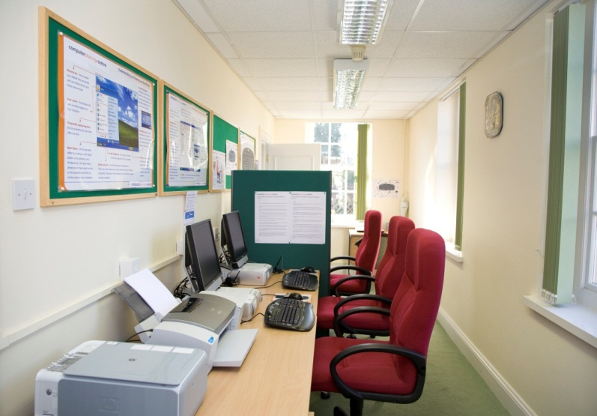
What to expect
Principles behind Computer Sharing Centres – what are they and how do they work?
Based on the understanding that being a confident internet user requires it to be a “way of life”…..
A Computer Sharing Centre is a high quality learning environment - enabling its members to use the internet the way they want*, when they want – so that they can enjoy the benefits.
*Computers are set to return to their original settings on log off – meaning that even catastrophic changes have no effect so you can do anything!
“Newly learnt skills are soon forgotten unless they are practised immediately”

Slide 5
What to expect
Who works in a Computer Sharing Centre?
Centre Manager, Instructors, Volunteer Supervisor, Centre Co-ordinator
All staff are “Ambassadors” - responsible for promoting the Centre, maintaining the environment and getting to know existing members.
Regular presentations promote the Computer Sharing Centre, encourage new members to join and give everyone a chance to get to know each other!
If the one-to-one lessons are not taken up the energy of the Centre and culture of learning will be lost.
“A healthy waiting list is important – people should only attend a term of lessons out of choice!”

Slide 6
What to expect
What happens in a Computer Sharing Centre?
Lesson sessions are available to members every week of the year (except Christmas!)
They are “easy, fun and one-to-one”™
Offering “continuous, informal tuition at your own pace” (this means that on completing a term of lessons the member immediately puts their name on the waiting list).
The shared computers are “robust, reliable and consistent”
and are available “all day, every day”
Unsupervised access to the Centre is only possible because of the culture of being a community of members who benefit from the regular lessons and presentations
All members are Inducted and must attend at least one 12 week term of lessons! – (most come back for more)
What do members use the computers for?
Email, booking tickets, shopping, digital photography, online banking….
“practise, practise, practise!”

Slide 7
What to expect
Profile of a Computer Sharing Centre Instructor:
Enjoys the internet and uses it daily. Is self-reliant and eager to improve their skills
Good with people, articulate, patient and kind, reliable and presentable
Expects to be five steps ahead of their student and makes time to learn new things
Has own memory stick and four email accounts with: Hotmail/live mail, Google mail, aol (Talktalk), Yahoo (Btinternet)
Is registered with Photobox – uses online banking and shops online

Slide 8
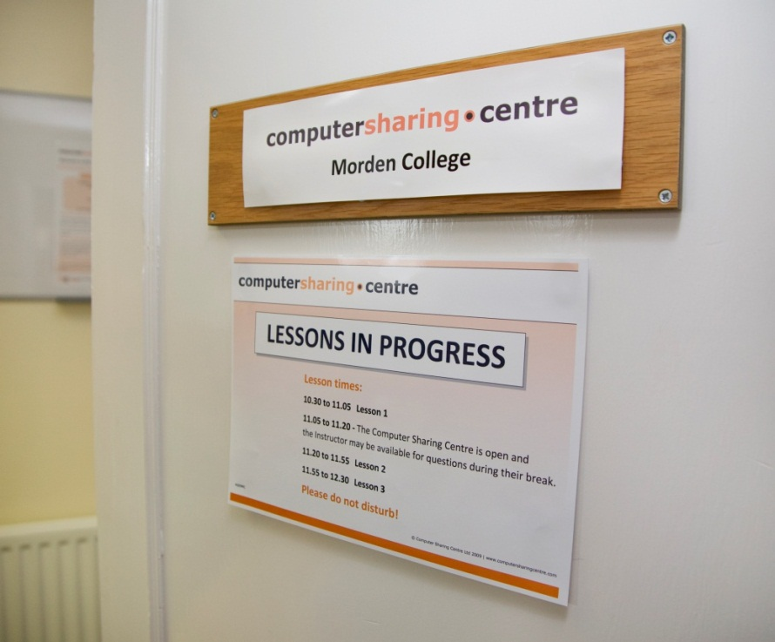
What to expect
Instructor approach
Instructors provide professional computer tuition at a Computer Sharing Centre - usually one morning a week
Instructors “lead the way” knowing that they are there to teach their student how to approach new computer tasks so that they have the confidence to manage on their own
All Instructors need to “sing from the same song sheet” - approaching computers in the same way, using the same support material
“Give a man a fish; you have fed him for today. Teach a man to fish; and you have fed him for a lifetime” Chinese proverb and Instructor’s approach to teaching

Slide 9
What to expect
Instructors work independently – without supervision
Completing the online “Lesson Session Summary” gives confirmation to the Centre Manager via email as well as providing a record of work done and general feedback (very useful!)
Liaison with the local Centre Co-ordinator helps manage lesson scheduling
Monthly review meetings provide feedback and support
Attendance at the Presentations (held 6/7 times a year) extend learning and the membership community is strengthened
Routine contact with the Manager via phone, text or email
Lessons are given using the method of “Computer Driving Instruction” where the student is in the driving seat at all times

Slide 10
What to expect
Instructor approach – just for fun…
from www.amatecon.com a personal site! about that fish?
The Improvements “Give a man a fish; you have fed him for today. Teach a man to fish; and you will not have to listen to his incessant whining about how hungry he is.”- Author unknown
“Give a man a fish; you have fed him for today. Teach a man to fish; and you can sell him fishing equipment.” - Author unknown
“Give a man a fish; you have fed him for today. Teach a man to use the Net and he won't bother you for weeks.” - Author unknown
“Teach a man to fish and you feed him for a lifetime. Unless he doesn't like sushi—then you also have to teach him to cook.” - Auren Hoffman, Herald Philosopher
This is a picture of the Instructor adjusting the monitor after the student has sat down – not best practise, she looks tense as her space is being invaded!

Slide 11
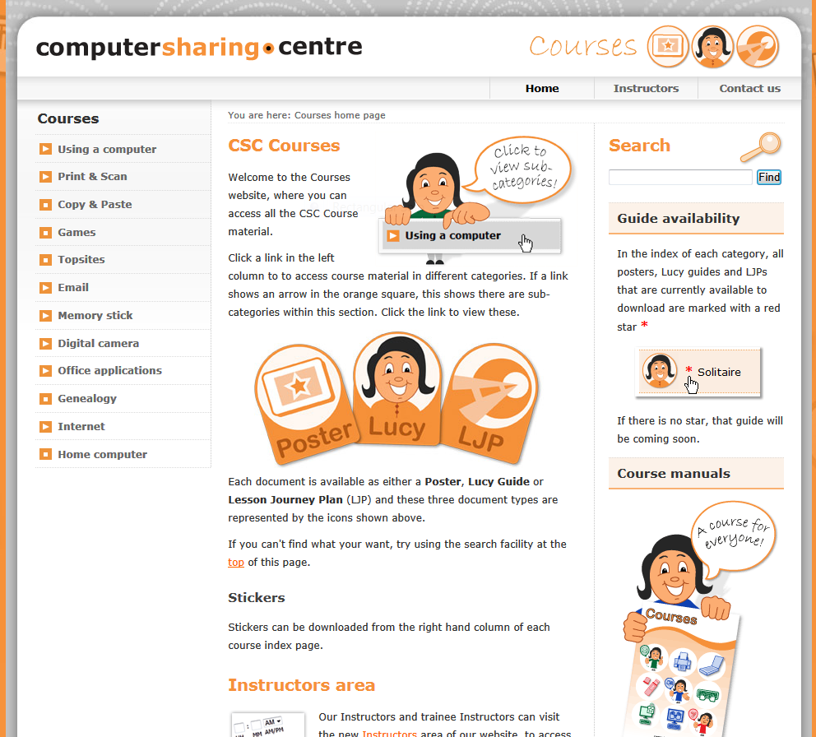
The Courses website
www.computersharingcentre.com/courses
Download guides with username and password
Give usernames and password details to trainees

Slide 12
Poster Guides - vocabulary
Give out posters
Remember: All Instructors need to “sing from the same song sheet” approaching computers in the same way using the same support material
The Poster Guides are very useful and give a focus to each 12 week term of lessons – the Instructors need to be familiar with them
Understanding your Desktop and Start Menu
Understanding what a “Window” is telling you
How can Instructors reinforce the information in a poster guide? Try the internet:
Think of some key words e.g. “windows xp desktop and start menu tutorial” and see what you get in Google.

Slide 13
Keyboard navigation
Keyboard use encourages the “fundamental approach to technology” that Instructors use
The screen is divided into active areas and clear symbols are given to indicate where the computer’s attention is (see Poster Guide)
Repeated tasks like maximising, minimising and closing a window can be done with the keyboard
Logging on and signing into email can all be done on the keyboard
Microsoft applications are best used by people with the right terms to describe tasks e.g. font or alignment – using the keyboard encourages you to use these and save mouse clicks once you are familiar with the “short cut”
Practise logging on, signing into email, maximising the window and zooming in – and remember over-use of the mouse causes RSI (Repetitive Strain Injury) resulting in severe hand and wrist pain!

Slide 14
Google search
The internet cannot speak – you have to communicate in text so words are the currency.
Understanding how to do a search in Google opens up the world wide web of information!
Try and find useful teaching on how t o use “Internet Explorer”

Slide 15
Summary
What to expect?
Principles behind Computer Sharing Centres –
A Computer Sharing Centre is a high quality learning environment - enabling its members to use the internet the way they want*, when they want – so that they can enjoy the benefits
Profile of a Computer Sharing Centre Instructor – “leading the way”
Good with people, articulate, patient and kind, reliable and presentable – a regular user of the internet!
Instructor’s approach
Instructor’s approach to teaching - “Give a man a fish; you have fed him for today. Teach a man to fish; and you have fed him for a lifetime”

Slide 16
Summary
The Courses site “singing from the same song sheet”
Poster guides for vocabulary - to take away and learn
Google search with A4 guide – to aid independent learning
Keyboard navigation (to be continued in the Centre)
Move to Computer Sharing Centre after presentation and learn the principles of keyboard navigation
Start to learn Poster Guides, Google search terms and arrange to come in and observe lessons starting at 11.20 and finishing at 12.30

