Slide 1

Computer Sharing Centre
Second Instructor Training Presentation

Slide 2

Introduction: Where are we now?
Three main training sessions – then what?
  Week one type first week’s date here 1-3pm:
    1 - What to expect, the Guides site, useful vocabulary with 12 A3 Poster Guides given out, Google search tips (A4 guide) – to aid learning, Keyboard Navigation (arrange to observe lessons from 11.20 to 12.30)
  Week two type second week’s date here 1-3pm:
    2 - Managing removable storage (digital camera memory cards and memory sticks), organising folders and files – with guide, revision of week one
  Week three type third week’s date here 1-3pm:
    Take a 30 minute test to be marked immediately.
    If successful: Receive membership Induction including a tour of the Centre
    3 – Lesson Processes. Receive an overview of the processes involved in the term of lessons (with two Instructor Guides) – ready to start immediately - with supervision!
    Book dates for Monthly Review meetings and Presentations –
  Monthly Review meetings
    Receive a “Monthly report” - a summary of lesson sessions carried out so you can: easily calculate your invoice, enjoy the chance to work together give and receive training and generally catch up with each other

Slide 3
Agenda
Monday type second week’s date here (1pm to 3pm)
  Welcome back – Introduction: Where are we now?
  Summary of work done last week, including revision of material for test – importance of email
  Discuss progress so far with assimilating all this information
  Blank Poster Guides to be given out and discussed
  Managing removable storage (memory cards from digital camera and memory sticks) – discuss and demonstrate
  File and Folder management – give out guide and demonstrate. Move to Computer Sharing Centre after presentation to go over “My Computer” and explore memory sticks and digital camera use.
  Summary with homework suggestions for next week

Slide 4

Summary from last week
What to expect?
  Principles behind Computer Sharing Centres –
    A Computer Sharing Centre is a high quality learning environment - enabling its members to use the internet the way they want*, when they want – so that they can enjoy the benefits
  Profile of a Computer Sharing Centre Instructor – “leading the way” Are all web mail email accounts set up?
    Good with people, articulate, patient and kind, reliable and presentable – a regular user of the internet!
  Instructor’s approach
    Instructor’s approach to teaching - “Give a man a fish; you have fed him for today. Teach a man to fish; and you have fed him for a lifetime”
The Courses site “singing from the same song sheet” How did this go?
Poster guides for vocabulary - to take away and learn More on this later…
Google search with A4 guide – to aid independent learning Email with links on its way
Keyboard navigation (to be continued in the Centre)
  Move to Computer Sharing Centre after presentation and learn the principles of keyboard navigation
  Continue to learn Poster Guides, & Google search terms and observe lessons this week type name/s and date/s here

Slide 5


Welcome back
General discussion of how revision work is coming on and any questions from last week?

Slide 6
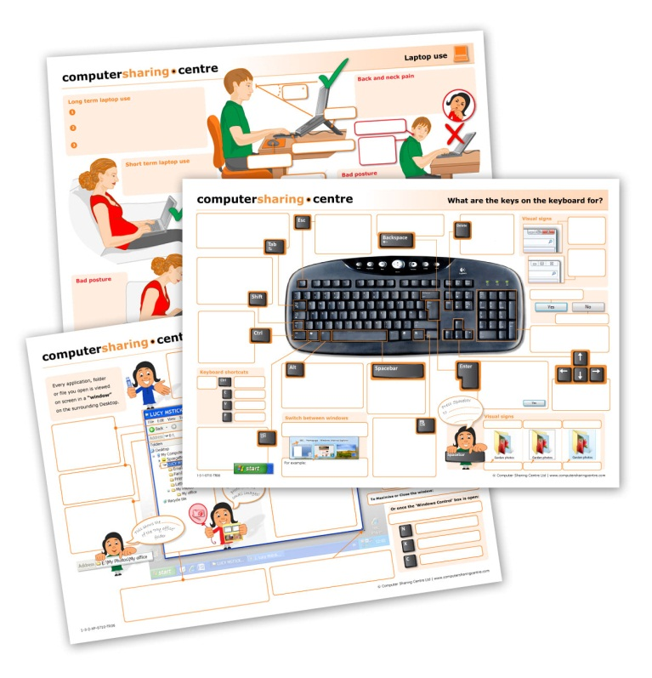
Poster guides – vocabulary
Give out blank Poster Guides for
8 posters (not email)
  Remember: All Instructors need to “sing from the same song sheet” approaching computers in the same way using the same support material
  The Poster Guides are very useful and give a focus to each 12 week term of lessons – the Instructors need to be familiar with them – so familiar that they can fill in the blank spaces!

Slide 7




Managing removable storage devices
Managing removable storage
  memory cards from digital camera
  memory sticks
Organising folders and files – using Windows Explorer
  Give out notes on “File and Folder Management” and demonstrate with “actual” files and folders
  Lesson in Computer Sharing Centre on naming and organising a memory stick

Slide 8

Summary
  Blank Poster Guides given out and discussed
  Managing removable storage (memory cards from digital camera and memory sticks) – discuss
  File and Folder management – give out notes and demonstrate
  Move to Computer Sharing Centre after presentation to go over “My Computer” and explore memory sticks and digital camera use.
  Summary with homework suggestions for next week – good luck in the test!

