Slide 1
Computer Sharing Centre YouTube
4 December 2013

Slide 2
YouTube - Agenda
YouTube introduction
How to set up a YouTube (also Google) account
How to find what you want. Then sit back and enjoy some videos using ‘Watch Later’

Slide 3
YouTube introduction
You Tube was bought by Google in 2006 click on the YouTube logo below to see a video created to celebrate its 7th birthday in October 2013 (it was launched in May 2005).

Slide 4
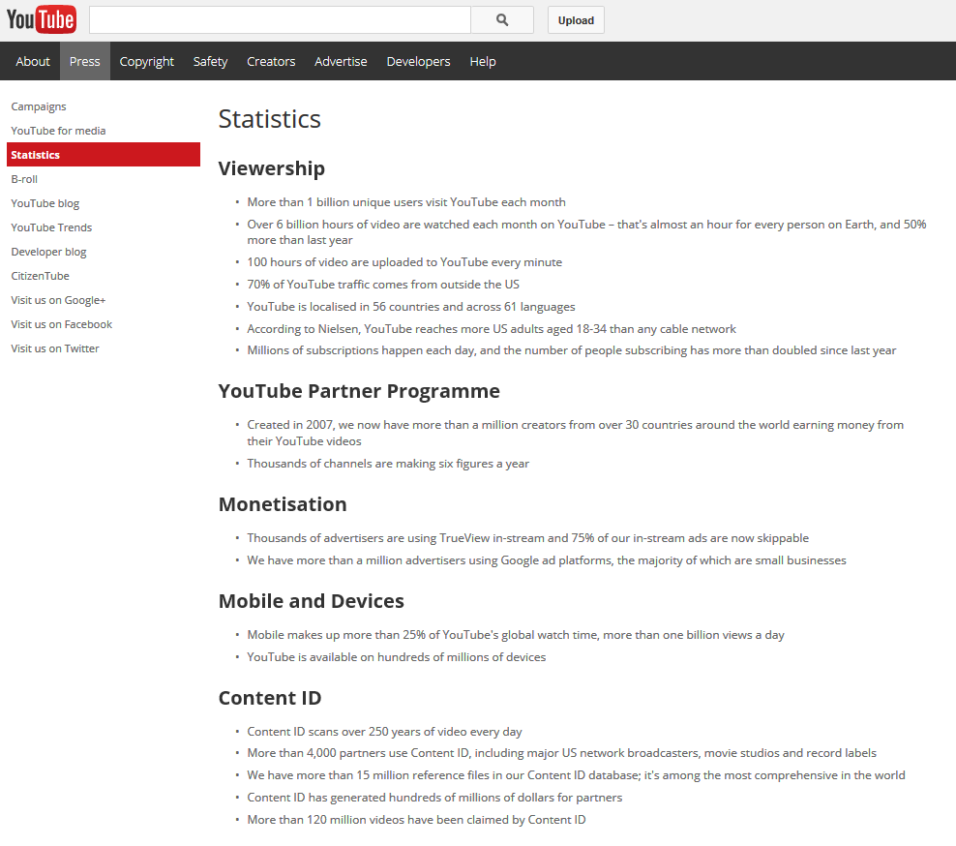
Introduction to YouTube
This page is from YouTube: http://www.youtube.com/yt/press/en-GB/statistics.html
More than 1 billion unique users visit YouTube each month
YouTube is localised in 56 countries and across 61 languages
Created in 2007, we now have more than a million creators from over 30 countries around the world earning money from their YouTube videos

Slide 5
Introduction to YouTube
We have more than a million advertisers using Google ad platforms, the majority of which are small businesses
Content ID scans over 250 years of video every day
More than 120 million videos have been claimed by Content ID

Slide 6
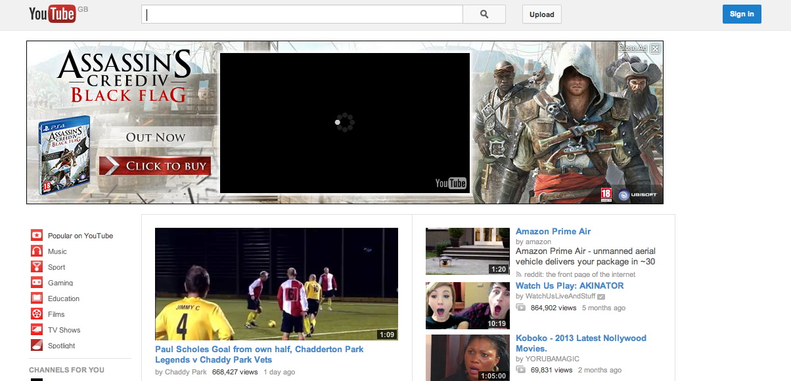
Introduction to YouTube
Use the Topsites page to go to YouTube

Slide 7
Introduction to YouTube
Using the words “how to”, search for a helpful video – like how to stuff a turkey?

Slide 8
Introduction to YouTube
Here’s an unusual recipe to follow!

Slide 9
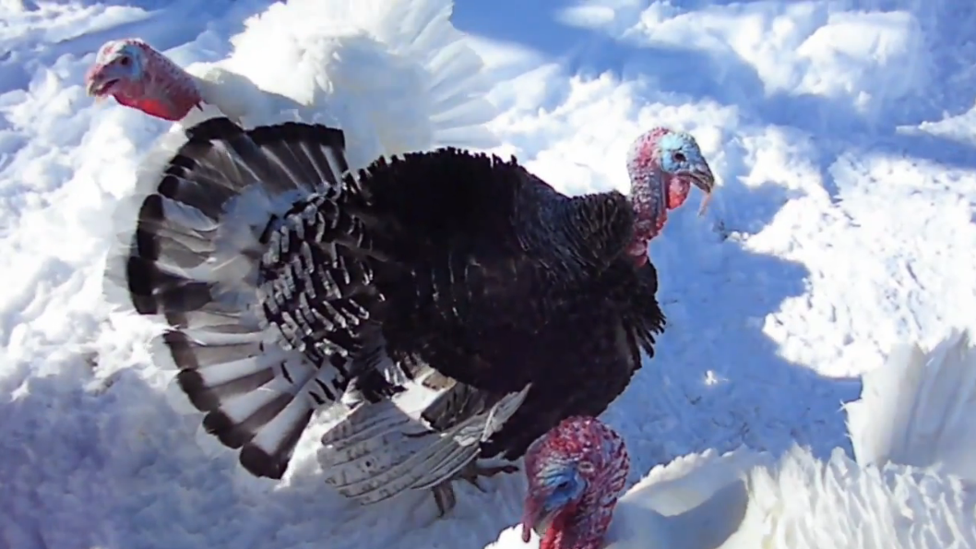
Introduction to YouTube
Or maybe you just want to see a turkey ‘gobble’?

Slide 10
Introduction to YouTube
YouTube can be helpful and fun –
And you can use it from your tablet/iPad or your smart phone!
Why not have a go!

Slide 11
How to set up a YouTube (also Google) account
here is one I did earlier for Thomas
But first, why bother?
After all, YouTube is really just a very powerful search engine for an impossible number of videos.
If you know how to search for a video…
why bother to have an account?

Slide 12
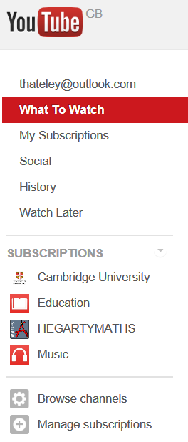
How to set up a YouTube (also Google) account
Why? because of the benefits (and it only takes a few minutes)!
This is the navigation pane or the ‘Guide’ for Thomas’s account
Watch Later is very useful as you can save interesting videos and ….watch them later!
YouTube have lots of well organised channels and you can subscribe to them here. Thomas is more likely to watch these now!

Slide 13
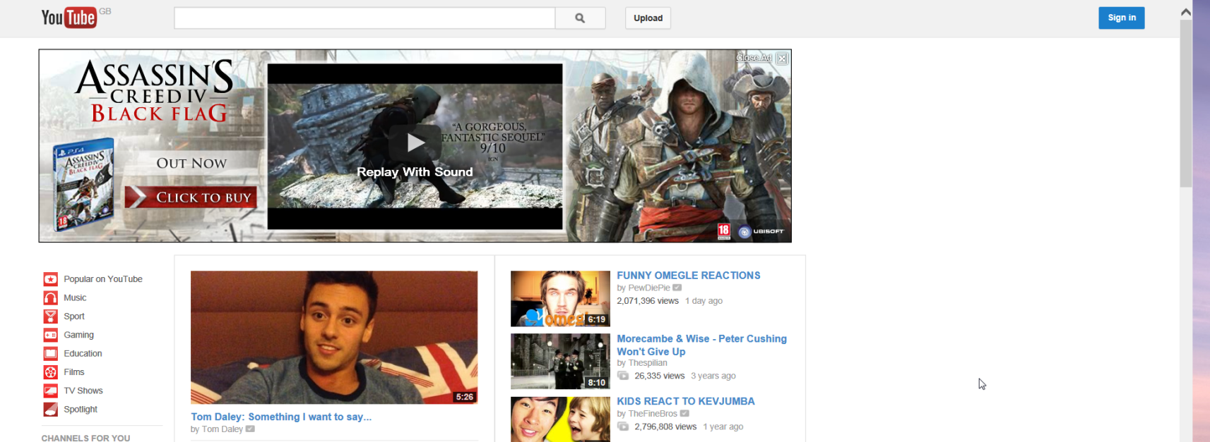
How to set up a YouTube (also Google) account
Step one. Go to the YouTube website and click on Sign in
This takes you to the sign in page

Slide 14
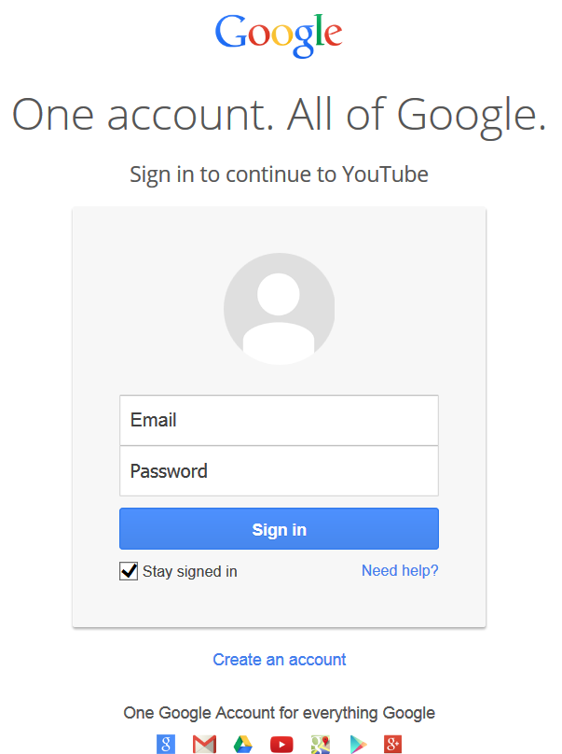
How to set up a YouTube (also Google) account
Step two. On the ‘sign in’ page click on “Create an account”
This takes you to the ‘Create a Google Account’ page
Once you have a YouTube/Google account you just type your email address and password here to sign in to it!

Slide 15
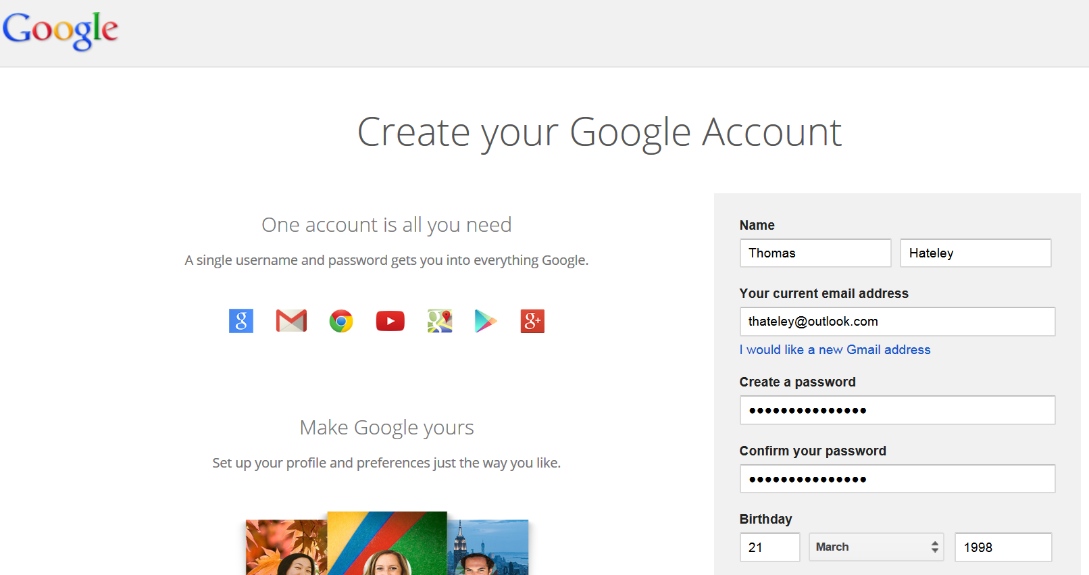
How to set up a YouTube (also Google) account
Step three: Fill in your name, email address, password and birthday

Slide 16
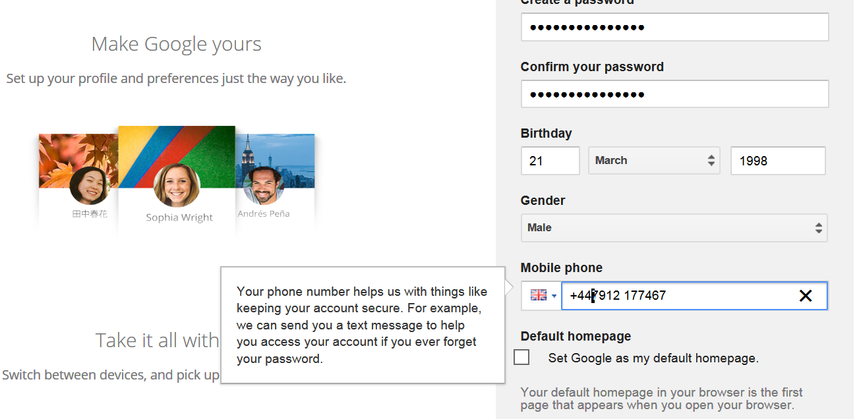
How to set up a YouTube (also Google) account
Step three continued: Give them your telephone number
They will try and get you to set Google as your homepage so always read everything. Uncheck the box to keep your current homepage.

Slide 17
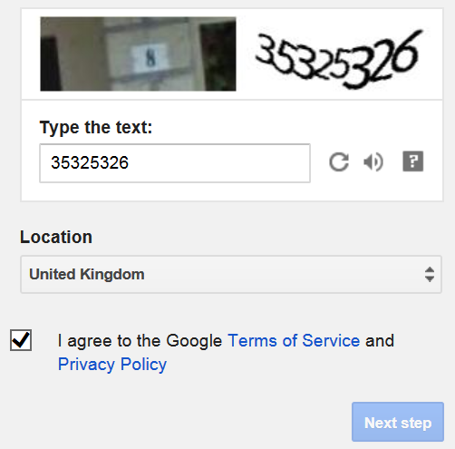
How to set up a YouTube (also Google) account
Step three continued: prove that you are a real person by typing in the numbers, then agree to the Google Terms of Service. Click on Next step

Slide 18
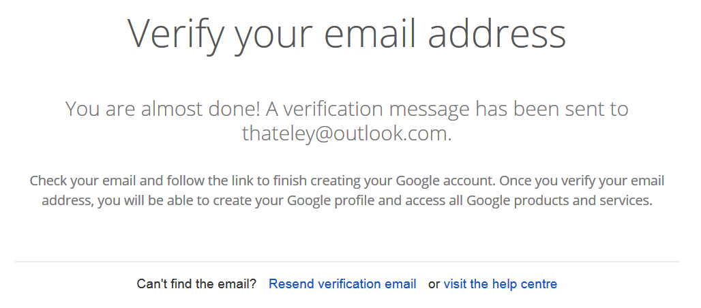
How to set up a YouTube (also Google) account
Step three is done….you have registered and you get this webpage

Slide 19
How to set up a YouTube (also Google) account
Step four – sign in to your email and read instructions….
This link will take you to the page where you put your photo if you want to….

Slide 20
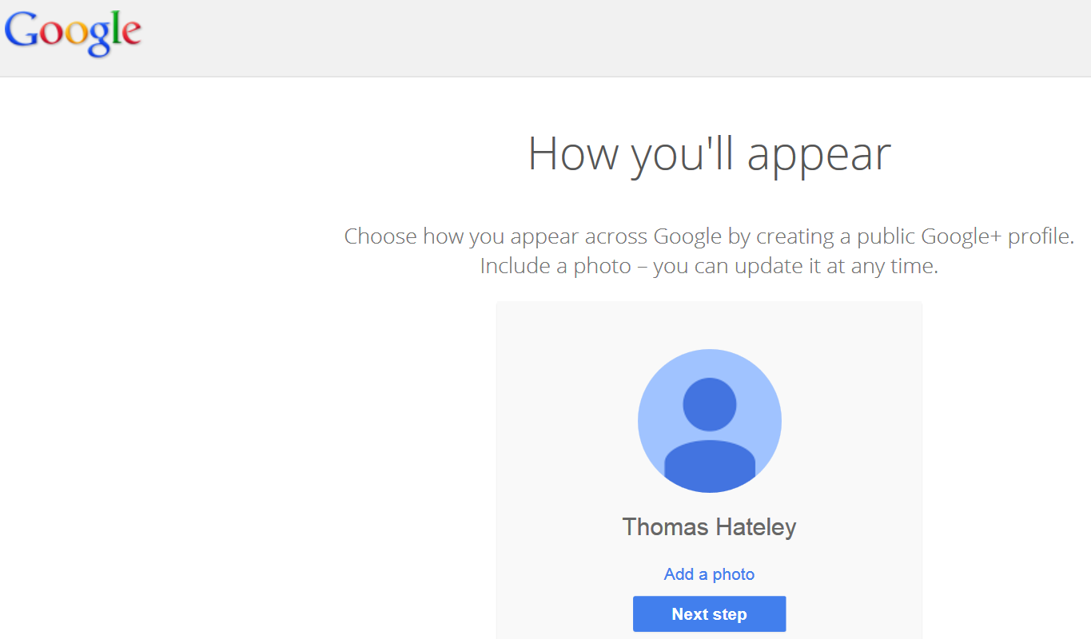
How to set up a YouTube (also Google) account
Step five: Click on the ‘activate your account’ link in your email to open this webpage where you can add a photo if you want (or do it later!)
Click here to add a photo

Slide 21
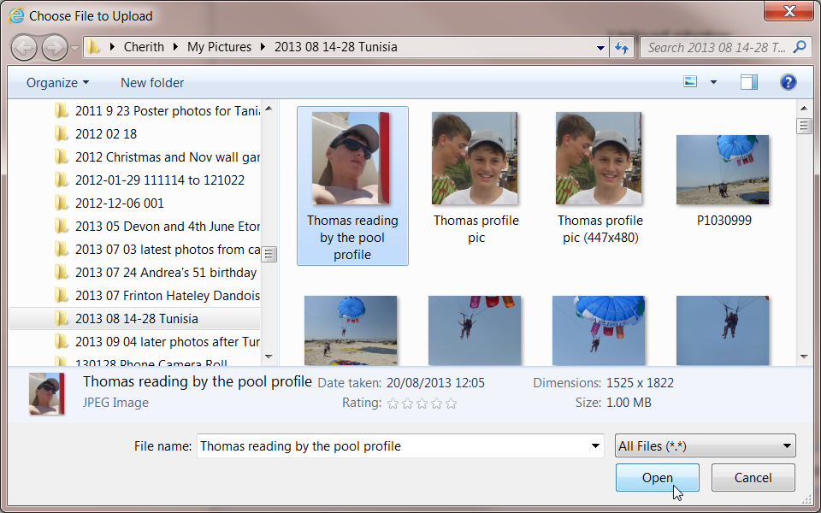
How to set up a YouTube (also Google) account

Slide 22
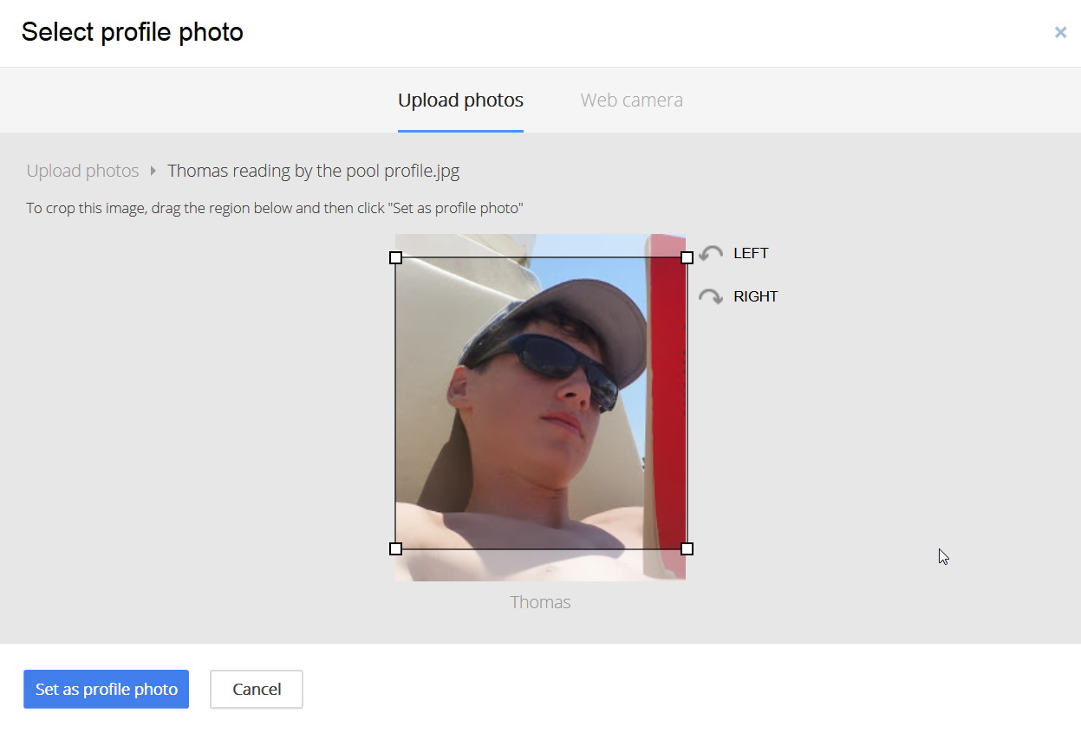
How to set up a YouTube (also Google) account

Slide 23
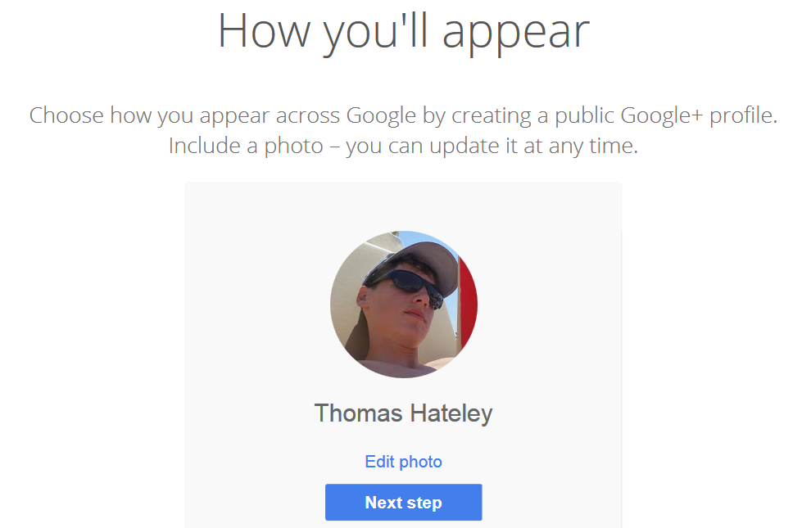
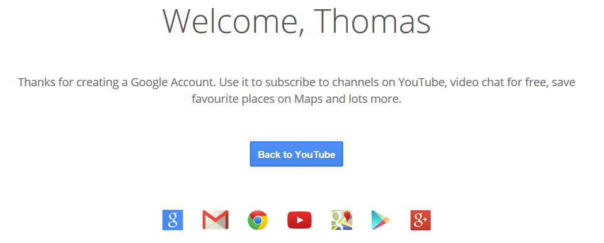
How to set up a YouTube (also Google) account
Finally you have your YouTube (really Google) account!
Click on ‘Next step’ to get……………

Slide 24
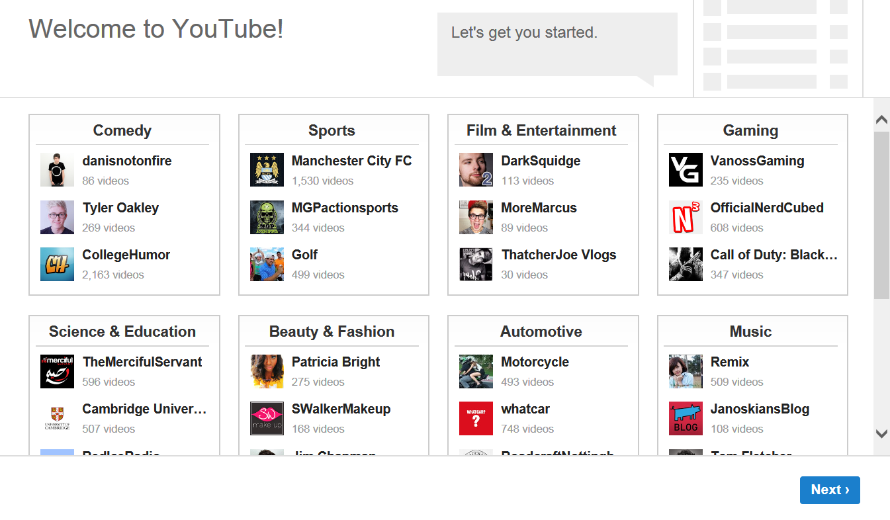
How to set up a YouTube (also Google) account
text
Subscribe to channels here and don’t forget to scroll down!

Slide 25
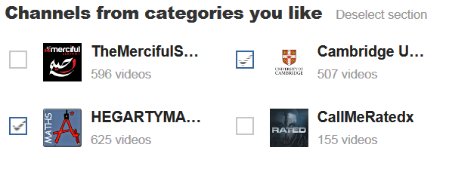
How to set up a YouTube (also Google) account
This area (known as the navigation pane or the ‘guide’) is why you should have your own account. The ‘My Subscriptions’ can be music as well as video.

Slide 26
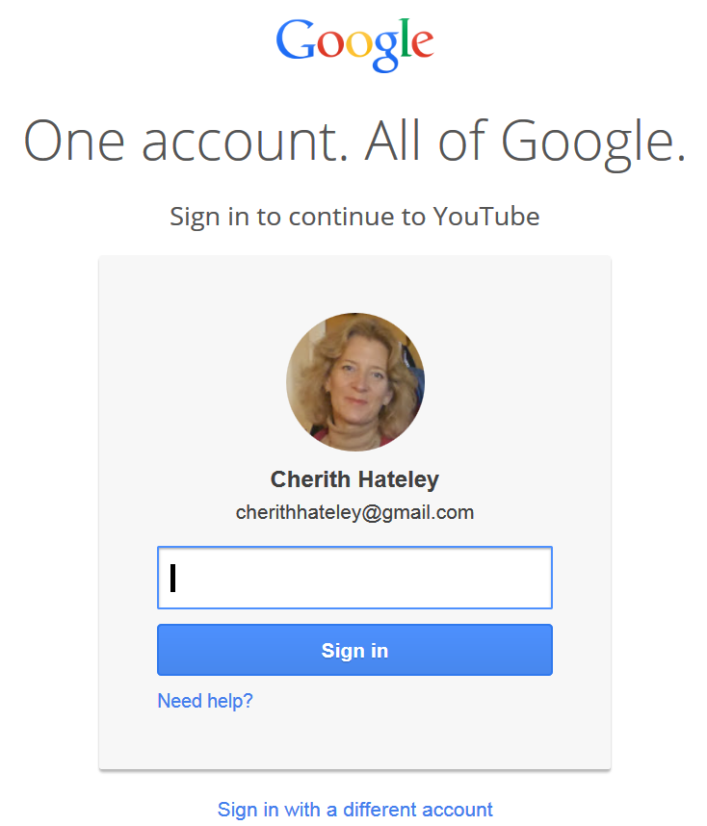
Why have a YouTube account?
Like with many things on the internet, YouTube is all about experience. The more you use it, the more you get out of it…
You don’t have to have an account but it will help you do more.
Your Instructor can help. The Lessons at the Centre are about working together on projects!
Thanks for listening.

Slide 27
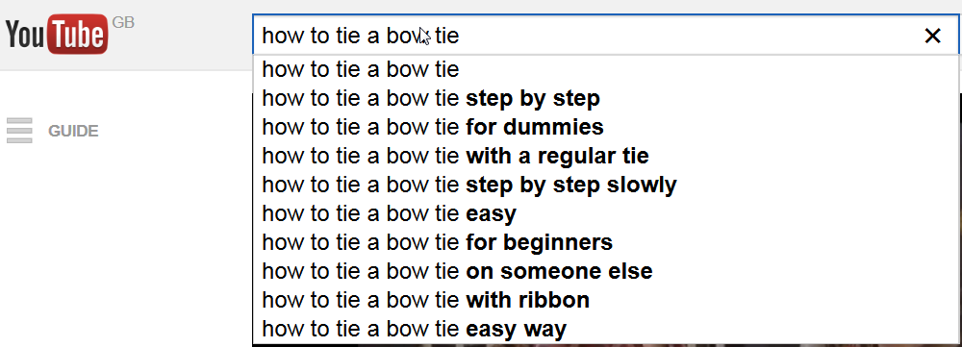
YouTube - How to find what you want
The YouTube search bar has a filter!
Let’s try and find a useful video on ‘how to tie a bow tie’ without using the filter, then using the filter…

Slide 28
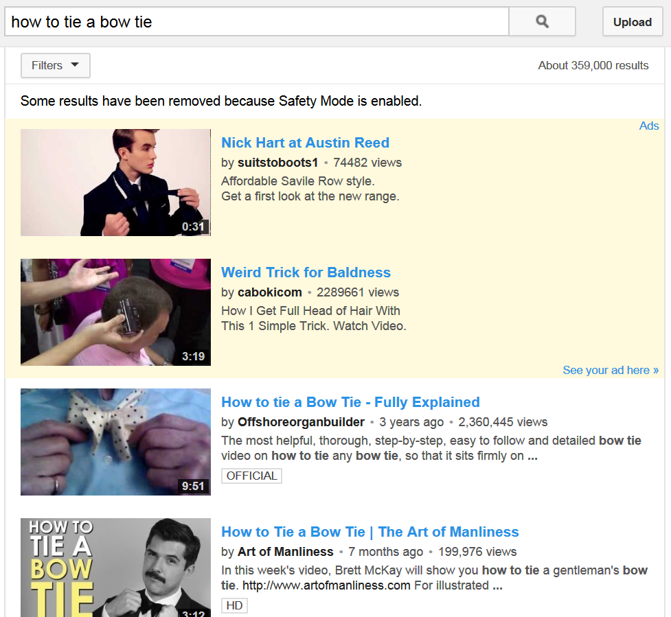
YouTube - How to find what you want
‘Relevance’ is the first priority that the search engine will use
359,000 results for these words…
This is the top result done 3 years ago and with
2,360,445 views

Slide 29
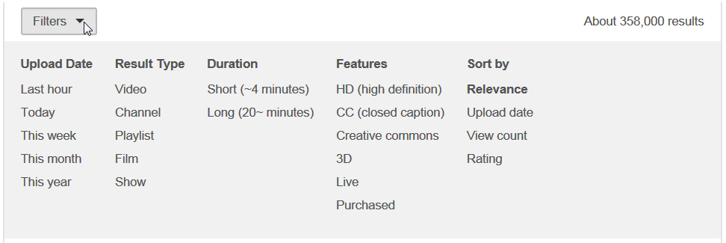
YouTube - How to find what you want
Click on the Filter button to see all the different options
Upload Date: Result Type: Duration: Features: Sort by:

Slide 30
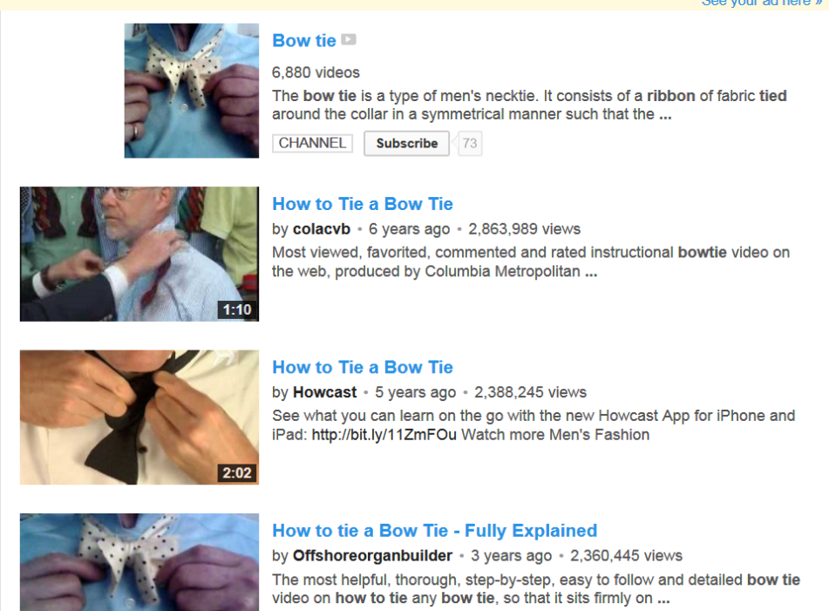
YouTube - How to find what you want
View count is a good one:
Now we have a different result with 2,863,989 views

Slide 31
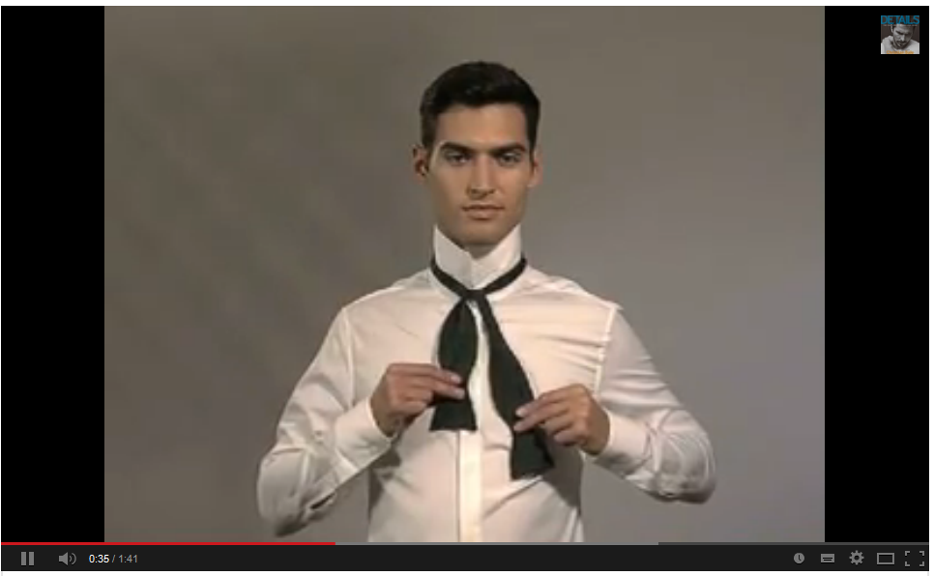
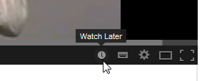
YouTube - How to find what you want
Use ‘Watch later’ (you must be signed in to your account)
It changes to a green tick
Click on the clock!

Slide 32
YouTube – Watch Later
Now you can watch it…. Later!
Click on your account to see useful options including Watch Later
Click on Watch Later here in your ‘guide’ and it will be waiting..

Slide 33
YouTube - Summary
YouTube introduction
How to set up a YouTube (also Google) account
How to find what you want. Then sit back and enjoy some videos using ‘Watch Later’
Have fun!

