Slide 1
Computer Sharing Centre Google 4 July 2012

Slide 2
Agenda and Introduction
Latest news from the Computer Sharing Centre
Google
by Cherith Hateley

Slide 3
Latest news from the Computer Sharing Centre
Computer Sharing Centre Monthly Report for May 2012
Environment: Cleanliness, computer reliability, broadband connection (speed and reliability)
The room was redecorated and set up with new chairs, new posters between 3 and 5th May (in time for the 7 May bank holiday)
New broadband line supplied by Open Telecom installed 29th May
Membership
Two new members joined in May. Total of 119 members able to use the Centre. Latest membership number is 135
Lesson attendance and subjects covered
42 lessons, with 40 attended (two students forgot and were sorry!), lots of work on keyboard navigation with the keyboard crew ☺

Slide 4
May Monthly Report
Computer Sharing Centre Monthly Report for May 2012
Waiting list to attend a term of lessons (now managed by Cherith)
Currently 39 names on the list
Waiting time 10 to 12 months, but in practice this varies
Cherith (Computer Sharing Centre Manager) is now responsible for arranging stand-ins (9 out of 42 lessons in May) and new students as Diane Payne has moved to HR.
Janet Gannon in the General Office promotes the Centre, arranges Inductions, and takes messages from students regarding cancellations
Drop in session attendance
Ten people benefited, tasks included booking flights and iPad introduction
Presentations 16 May “Digital Photography – print photos using the internet” Portrait photos taken ☺

Slide 5
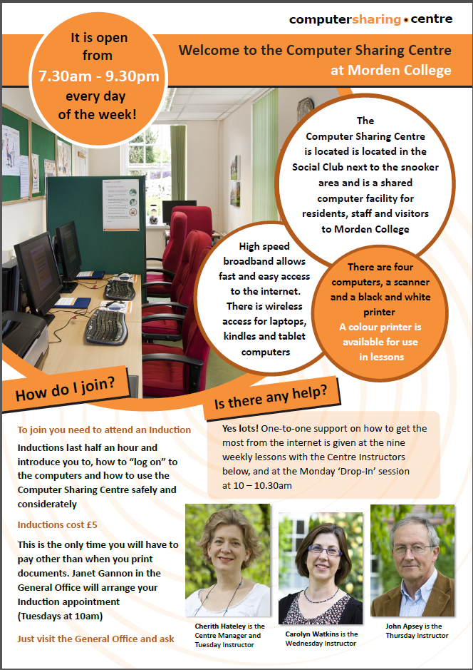
New leaflet for Computer Sharing Centre
An A3 poster of this is in the cabinet outside the Computer Sharing Centre. Janet and Val in the General Office will give A4 (normal size!) out to residents and staff

Slide 6
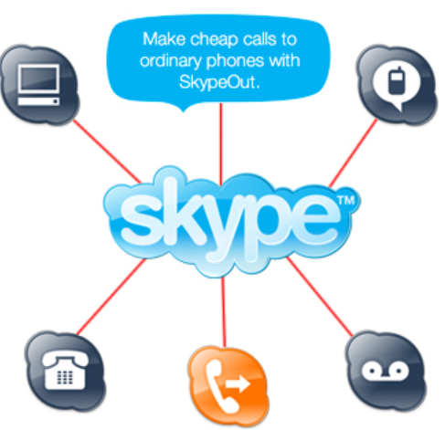
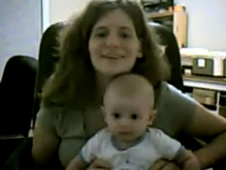
Possible new Skype service!
We are also looking into providing free Skype sessions at the weekends:
Saturday and Sunday at
10-11am and 7-8pm
where the Centre will be used only for Skype calls to friends and family (probably abroad but not necessarily!)
Please speak to one of the Instructors afterwards if you are interested in either Skyping or being a support volunteer.

Slide 7
Google
How does Google work?
How does Google make money?
Introduction to the Google “Results page”
How to search the world wide web with Google
Searching for information on Google
Searching for news on Google
Searching for images on Google
Searching for videos on Google
Notes:
Description
Google Inc. (Google) is a global technology company focused on improving the ways people connect with information. The Company generates revenue primarily by delivering online advertising. As of December 31, 2011, the Company’s business was focused on areas, such as search, advertising, operating systems and platforms, and enterprise. Businesses use its AdWords program to promote their products and services with targeted advertising. In addition, the third parties that comprise the Google Network use its AdSense program to deliver relevant advertisements that generate revenue. In June 2011, the Company launched Google+, a way to share online. As of January 2012, over 90 million people had joined Google+. In April 2011, the Company acquired PushLife. In September 2011, the Company acquired Zagat. In May 2012, Google acquired Motorola Mobility Holdings, Inc.(MMI).

Slide 8
Google
How does Google work?
Fact: Google’s system does search every page on the world wide web (some more frequently than others) and when a study group measured it in 2007, there were 750 billion web pages!
Fact: Google indexes every word (except common short words like ‘a’, ‘and’, ‘the’) on every web page and uses at least 500 powerful computers to perform your search, returning the results in half a second.
Notes:
Description
Google Inc. (Google) is a global technology company focused on improving the ways people connect with information. The Company generates revenue primarily by delivering online advertising. As of December 31, 2011, the Company’s business was focused on areas, such as search, advertising, operating systems and platforms, and enterprise. Businesses use its AdWords program to promote their products and services with targeted advertising. In addition, the third parties that comprise the Google Network use its AdSense program to deliver relevant advertisements that generate revenue. In June 2011, the Company launched Google+, a way to share online. As of January 2012, over 90 million people had joined Google+. In April 2011, the Company acquired PushLife. In September 2011, the Company acquired Zagat. In May 2012, Google acquired Motorola Mobility Holdings, Inc.(MMI).

Slide 9
Google
Description
Google Inc. (Google) is a global technology company focused on improving the ways people connect with information. The Company generates revenue primarily by delivering online advertising. As of December 31, 2011, the Company’s business was focused on areas, such as search, advertising, operating systems and platforms, and enterprise. Businesses use its AdWords program to promote their products and services with targeted advertising. In addition, the third parties that comprise the Google Network use its AdSense program to deliver relevant advertisements that generate revenue. In June 2011, the Company launched Google+, a way to share online. As of January 2012, over 90 million people had joined Google+. In April 2011, the Company acquired PushLife. In September 2011, the Company acquired Zagat. In May 2012, Google acquired Motorola Mobility Holdings, Inc.(MMI).

Slide 10
Google
How does Google work?
Fact: If you know how to use Google you can certainly find useful and relevant information
(but only if you can avoid getting distracted by the not so relevant!)
This is how it works
• Google sees all letters as lower case so ignores capitals and punctuation
• Choose your keywords wisely (less is more). Select descriptive, specific words and put the most important word first!

Slide 11
Google
How does Google work?
Before you do a search on Google decide exactly what you are looking for and write it down!
This will save you a lot of time. We will try this out later
Get to know the ‘Google Results Page’ and then experiment – the way to learn is to have a go!
Just play!

Slide 12
Google
How does Google make money?
Fact: Money is made by “AdWords” which put relevant advertisements next to Google’s own search results – and AdSense, that puts Google’s context driven adverts on other web sites.
How much is Google worth and what impact is it having on business?
Fact: As of 22 June 2012 Market capitalisation was $186.32B
(Facebook is worth $77.32)
Fact: Google own YouTube

Slide 13
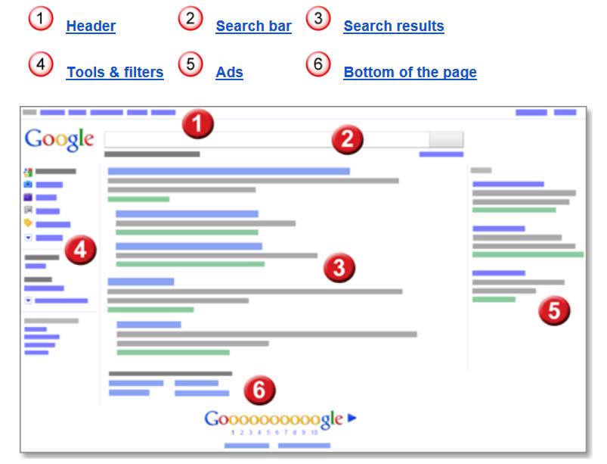
Google
Introduction to the Google “Results page”

Slide 14
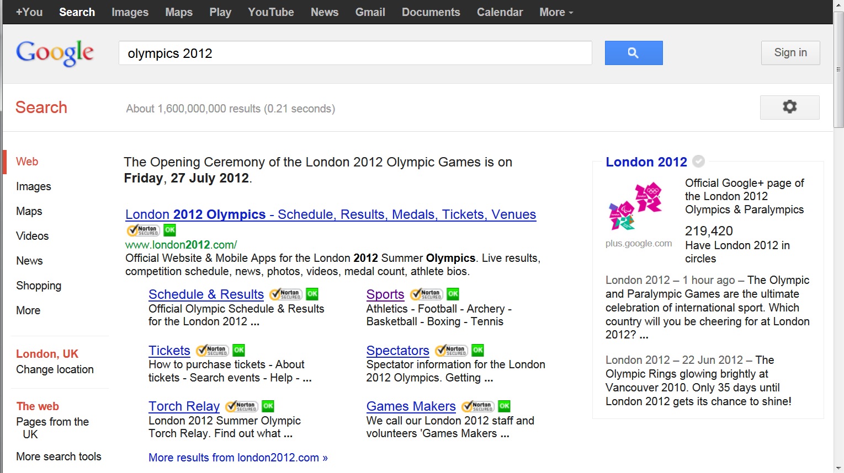
Google
1. Header: Google products bar
1. Header: Sign in and “Gear”
2. Search bar (press Enter)
2. Search bar: Statistics
3. Search results
Title: The first line of any search result is the title of the webpage. Click the title to reach that webpage.
URL: In green, you'll see the web address of that result's webpage.
Snippet: Below the URL is a description of the webpage and can include an actual excerpt of text from the page. Your search terms will appear in bold to make it easier for you to decide if the page has what you're looking for
4. Tools and filters
5. Ads The ads are relevant to your search and can be above the search results as well as to the side. When you click on them someone pays!

Slide 15
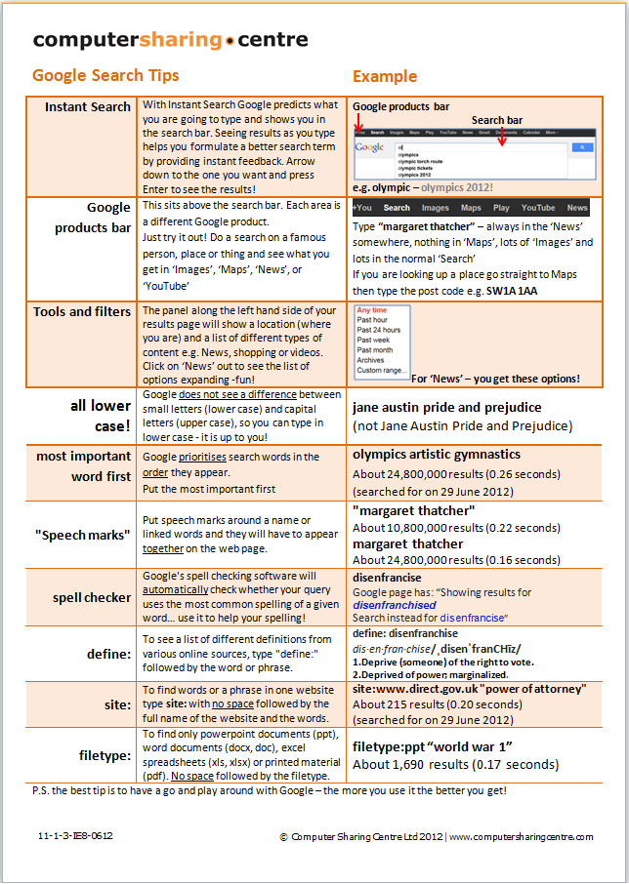
Google
Google search tips for you to take home

Slide 16
Google
Google search tips for you to take home

Slide 17
Google
Google search tips for you to take home

Slide 18
Google
Google search tips for you to take home

Slide 19
Google
Google search tips for you to take home

Slide 20
Google
How to search the world wide web with Google
Searching for information on Google
Searching for news on Google
Searching for images on Google
Searching for videos on Google
Please write down some ideas – now we are going to give it a try!

