Slide 1

Computer Sharing Centre
Third Instructor Training Presentation

Slide 2

Introduction: Where are we now?
Three main training sessions – then what?
  Week one type first week’s date here 1-3pm:
    1 - What to expect, the Guides site, useful vocabulary with 12 A3 Poster Guides given out, Google search tips (A4 guide) – to aid learning, Keyboard Navigation (arrange to observe lessons from 11.20 to 12.30)
  Week two type second week’s date here 1-3pm:
    2 - Managing removable storage (digital camera memory cards and memory sticks), organising folders and files – with guide, revision of week one
  Week three type third week’s date here 1-3pm:
    Take a 30 minute test to be marked immediately.
    If successful: Receive membership Induction including a tour of the Centre
    3 – Lesson Processes. Receive an overview of the processes involved in the term of lessons (with two Instructor Guides) – ready to start immediately - with supervision!
    Book dates for Monthly Review meetings and Presentations –
  Monthly Review meetings
    Receive a “Monthly report” - a summary of lesson sessions carried out so you can: easily calculate your invoice, enjoy the chance to work together give and receive training and generally catch up with each other

Slide 3

Agenda
Monday type date here (1pm to 3pm)
  Welcome back – Introduction: Where are we now – almost ready?
  Summary of work done last week (10 mins)
  30 minute “Trainee Instructor” test (40 mins)
    Take the Test. Mark each others. 90% pass mark (if below the test can be re-taken)
      20 minute break for coffee and – assuming successful results in test, agree dates for
      Monthly Review Meetings ☺
    Go to Computer Sharing Centre to undergo formal membership Induction with tour (30 minutes).
  Return to meeting room for
    ‘Membership and Lesson Organisation in a Computer Sharing Centre’ – presentation on how it all works (15 minutes)
    Giving a lesson in a Computer Sharing Centre – discussion and guides to take away
Briefly discuss what has been achieved by this training course and future expectations – Cherith to attend Instructor’s first lesson sessions this week
    N.B. Paperwork to be completed and signed by Trainee Instructors and Manager prior to lesson session

Slide 4


Summary from last week
  Blank Poster Guides given out and discussed
  Managing removable storage (memory cards
  from digital camera and memory sticks) –
    demonstrated connecting a memory card and memory
    stick to the laptop then viewing the drives in
    “Computer” – under Devices with Removable Storage
  File and Folder management –
    gave out notes and created and named new folders and copied, cut and pasted files into folder
  Moved to Computer Sharing Centre and went over “My Computer” with memory sticks and digital camera
  Attended and supported the “Be Organised” presentation on 21 September
  Observed two lessons and completed the “Lesson Session Summary” online form

Slide 5

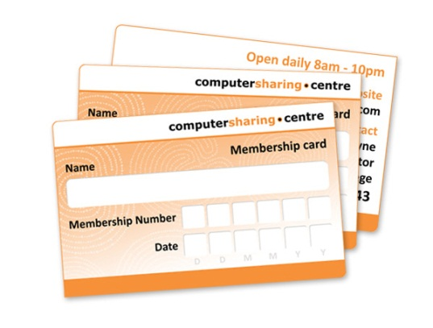
Take the test
  30 minute “Trainee Instructor” test
  Mark the test. Success?
  Newly qualified ‘Trainee Instructors’ receive
  their Induction and membership cards

Slide 6
Take a break

Slide 7

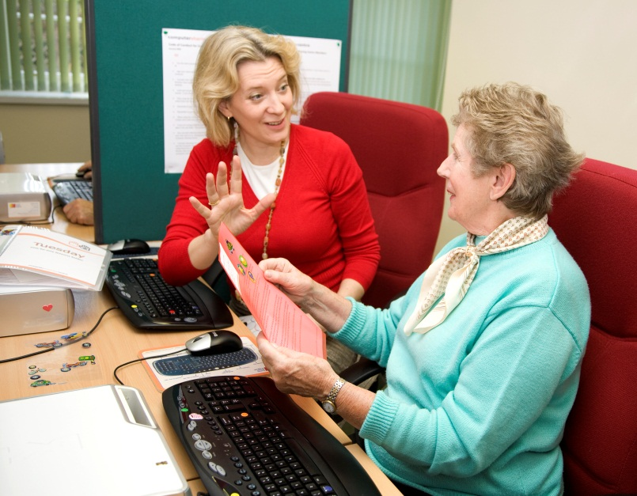
What we do!
‘Membership and Lesson Organisation in a Computer Sharing Centre’ presentation – what we do:
  Computer Sharing Centre
  Membership Process
  12 Week Term of Lessons Chart

Slide 8
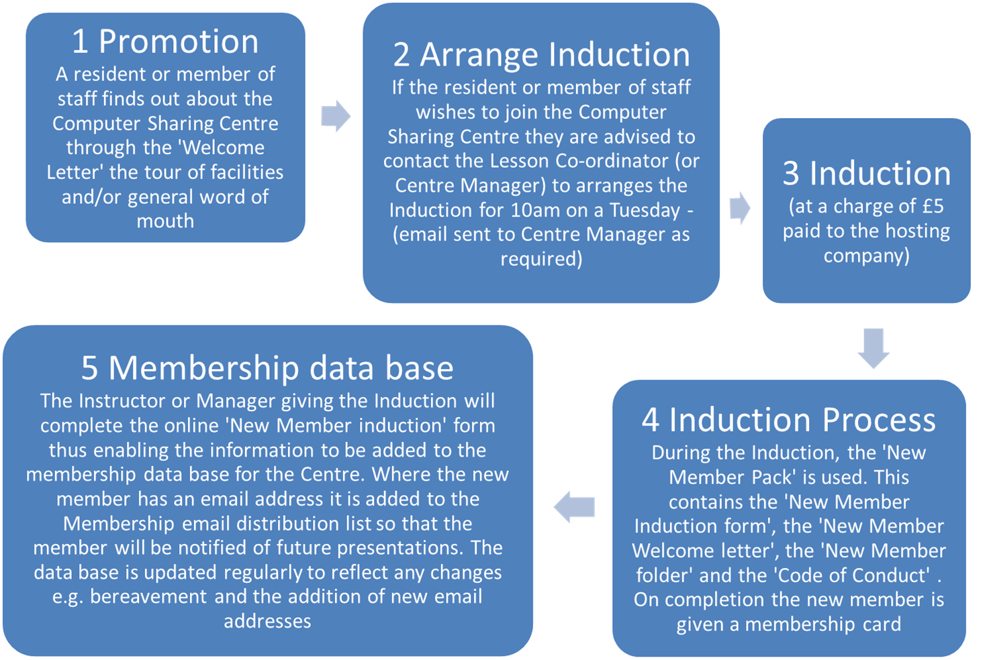
Computer Sharing Centre Membership Process

Slide 9
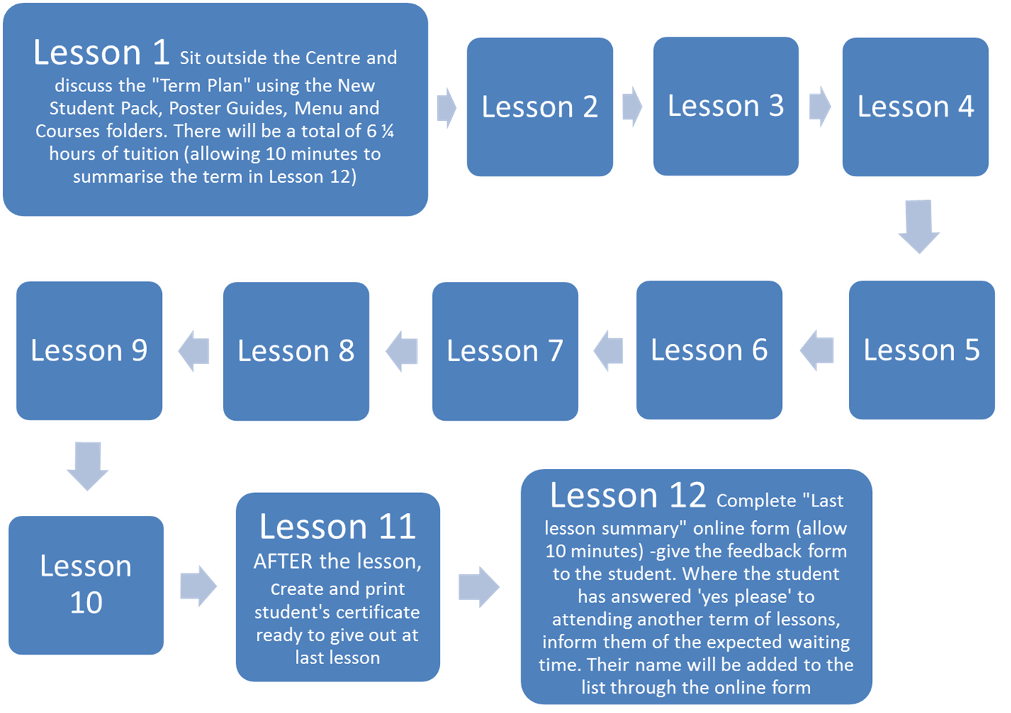
12 Week Term of Lessons Chart

Slide 10
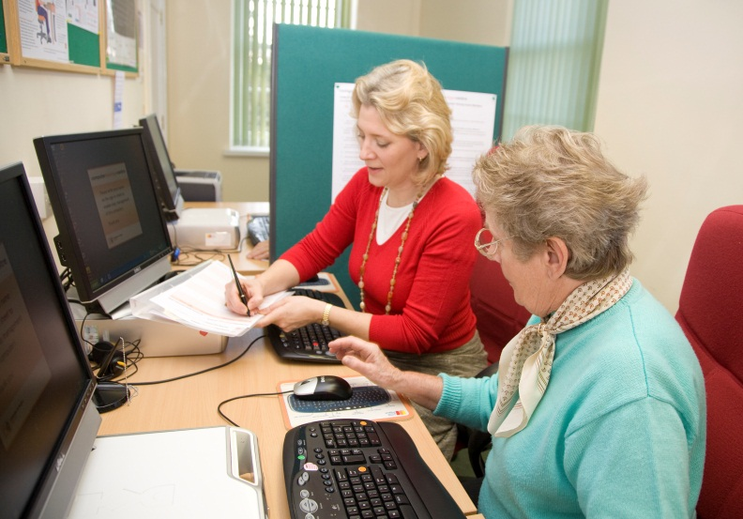
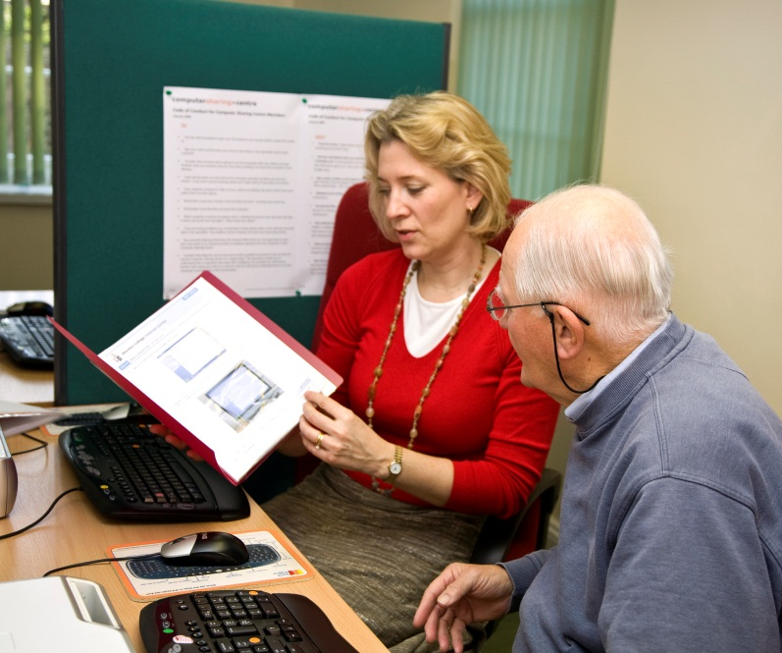
Giving a lesson in a Computer Sharing Centre
  Hand out the Instructor Guides on ‘Giving a lesson in a Computer Sharing Centre’ and ‘Starting and finishing a 35 minute lesson’
  Discuss the difficulties in giving instructions at a computer, and in general why the “Driving Instructor” analogy works well – but only up to a point!

Slide 11



What have we achieved?
Discuss what has been achieved by this training course and future expectations -

Slide 12
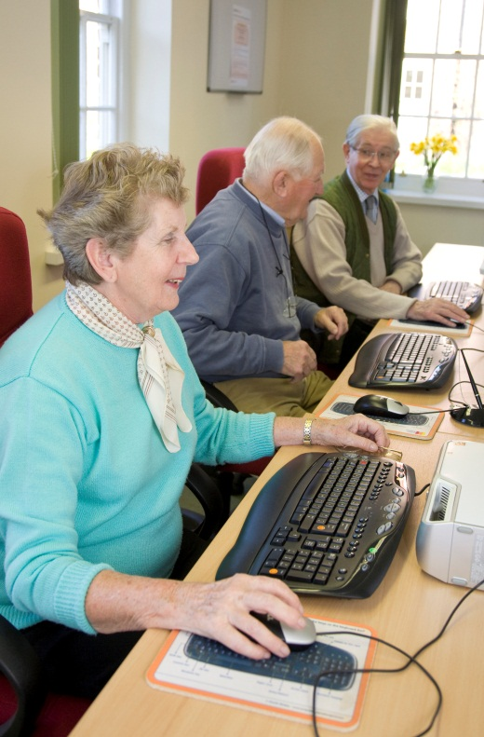
Summary
  Take the 30 minute Test and mark it together.
    Break for coffee and – assuming successful results in
    test, agree dates for Monthly Review Meetings
  Go to Computer Sharing Centre to undergo formal
  membership Induction with tour.
  Return to meeting room for a presentation on:
    “Membership and Lesson Organisation in a Computer
    Sharing Centre - how it works”
    Giving a lesson in a Computer Sharing Centre –
    discussion and guides to take away and learn
  Briefly discuss what has been achieved by this training course and future expectations – Cherith to attend Instructor’s first lesson sessions this week
    N.B. Paperwork to be completed and signed by Trainee Instructors and Manager prior to lesson session

